Slide 1


Jenkins Overview
Topics
What and Why Jenkins
Continuous Integration
Setup and Configuration
Jenkins tool walk through
Jenkins Plugins
Jenkins-Pipeline & Jenkinfile
Q&A
Session Coming on:
Topic : Jenkins Overview
Date : 26th Sept, 2018
Timing : 2:30 PM to 3:30 PM IST
Presenter : Suraj M B
Account : GE Corporate
Visit Us @: Capgemini GE GDC Intranet
Feedback @: GEInnovation@capgemini.com
Notes:
Fixar a posicao do titulo – sempre do lado esquerdo.
Sempre que tiver muito texto o coluna deve sempre ser “ narrowed” , se nao fica dificil de ler. Colocar paragrafos no texto.
Linha vertical deve ser mais fina e as pontas NUNCA devem ser arredondadas.

Slide 2
What and Why Jenkins
What is Jenkins :
Jenkins is a Continuous Integration (CI) server or tool which is written in java.
It provides Continuous Integration services for software development.
Jenkins is free software to download and install.
Why Jenkins :
Jenkins is the inspector in the analogy.
Middle man between your code repo and your build server.
It checks for changes, If it found them, it gathers them and sends them to your build server. That's what Jenkins is.

Slide 3
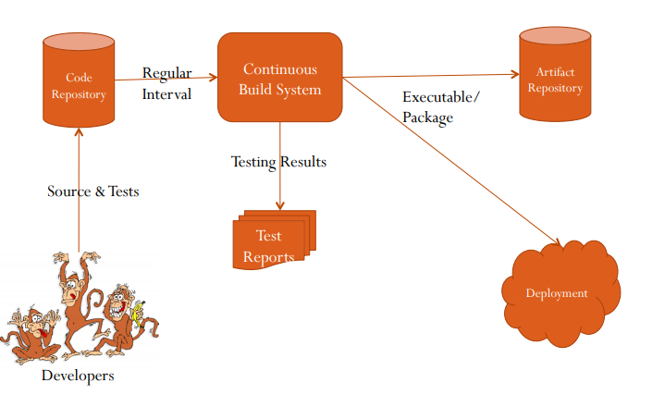
Continuous Integration
Continuous Integration (CI) is a development practice that requires developers to integrate code into a shared repository several times a day. It is a process of running your tests on a non-developer (say testers) machine automatically when someone pushes new code into the source repository. The below diagram shows the CI workflow.
Key Roles of CI :
Developers
Repository
Continuous Build System
Reports
Artifacts
Deployments

Slide 4
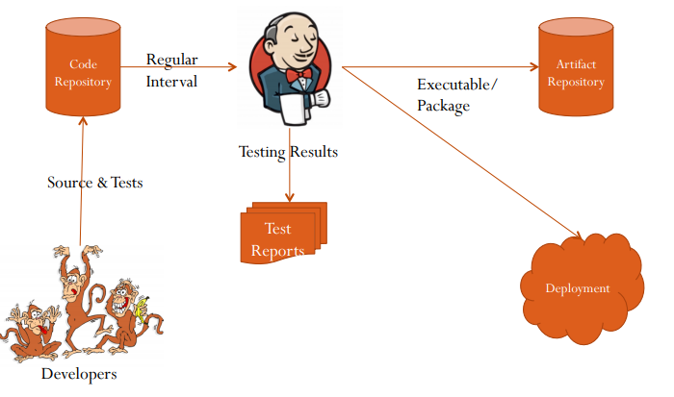
Where we can fit the Jenkins in CI
Key Roles of CI with Jenkins :
Developers
Repository
Jenkins
Reports
Artifacts
Deployments

Slide 5
Setup and Configuration
Prerequisites:
Minimum hardware requirements
256 MB of RAM
1 GB of drive space
Recommended hardware configuration for a small team:
1 GB+ of RAM
50 GB+ of drive space
Software requirements:
Java: Java 8 ,runtime environment, both 32-bit and 64-bit versions are supported
Web browser: Web Browser Compatibility with system.
Google Chrome,Morzilla etc.
The (WAR) file version of Jenkins can be installed on any operating system or platform that supports Java.
Download the latest stable Jenkins WAR file
Open up a terminal/command prompt & Run the command java -jar jenkins.war.
Browse to http://localhost:8080 and wait until the Unlock Jenkins page appears.

Slide 6
Jenkins Tool Walkthrough
Demo

Slide 7
Jenkins Plugin
Demo

Slide 8
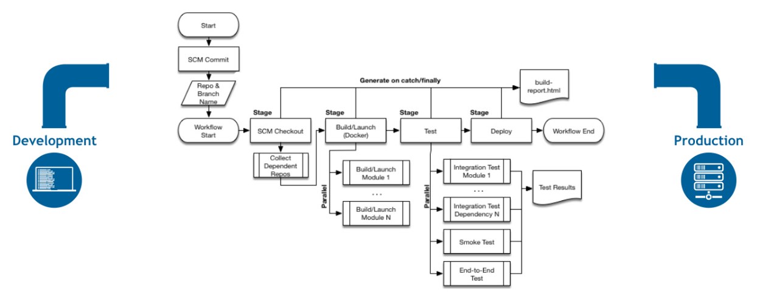
Jenkins Pipeline and Jenkinfile
What is a Jenkins pipeline?
A pipeline is a collection of jobs that brings the software from version control into the hands of the end users by using automation tools. It is a feature used to incorporate continuous delivery in our software development workflow.

Slide 9
Jenkins Pipeline and Jenkinfile (Contd)
Pipeline Concepts:
Pipeline:
user-defined model
defines your entire build process,
includes stages for building, testing and delivering.
Node
A node is a machine which is part of the Jenkins environment and is capable of executing a Pipeline.
Stage
distinct subset of tasks performed through the entire Pipeline
Like "Build", "Test" and "Deploy" stages
Step
step that tells Jenkins what to do at a particular point in time

Slide 10
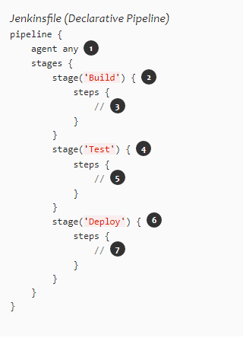
Jenkins Pipeline and Jenkinfile (Contd)
Pipeline syntax overview
Declarative Pipeline syntax and Scripted Pipeline syntax
Declarative Pipeline fundamentals
The Pipeline block defines all the work done throughout Pipeline.
Execute this Pipeline or any of its stages, on any available agent.
Defines the "Build" stage.
Perform some steps related to the "Build" stage.
Defines the "Test" stage.
Perform some steps related to the "Test" stage.
Defines the "Deploy" stage.
Perform some steps related to the "Deploy" stage.

Slide 11
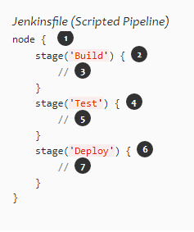
Jenkins Pipeline and Jenkinfile (Contd)
Scripted Pipeline fundamentals
One or more node blocks do/es the core work throughout the entire Pipeline.
Schedules the steps contained within the block to run by adding an item to the Jenkins queue. As soon as an executor is free on a node, the steps will run.
Creates a workspace (a directory specific to that particular Pipeline) where work can be done on files checked out from source control.
Execute this Pipeline or any of its stages, on any available agent.
Defines the "Build" stage. stage blocks are optional in Scripted Pipeline syntax. However, implementing stage blocks in a Scripted Pipeline provides clearer visualization of each `stage’s subset of tasks/steps in the Jenkins UI.
Perform some steps related to the "Build" stage.
Defines the "Test" stage.
Perform some steps related to the "Test" stage.
Defines the "Deploy" stage.
Perform some steps related to the "Deploy" stage.

Slide 12
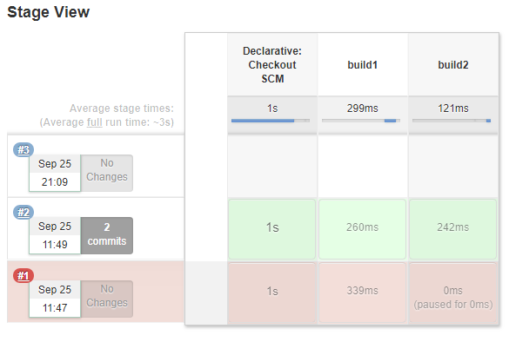
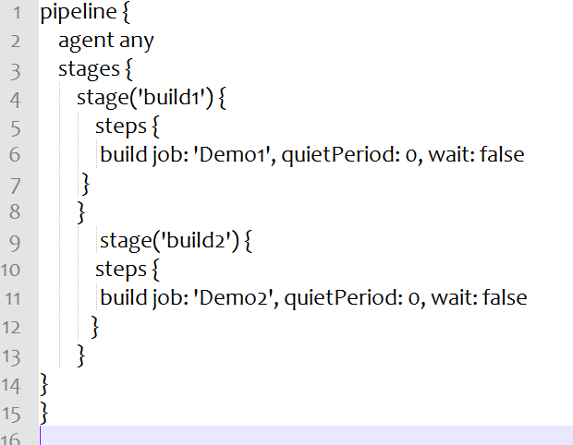
Jenkins Pipeline and Jenkinfile (Contd)

Slide 13
Any Questions?

Slide 14
Thank You!!

